Slide 1

TITLE: BRAIN TUMOR DETECTION
FACULTY: MALATHI G
COURSE NAME: DIGITAL IMAGE PROCESSING
COURSE CODE: SWE1010
REVIEW-3
TEAM MEMBERS:
S.NO | NAME | REGISTER NUMBER
1. | A.MOHITH | 19MIS1007
2. | MANOJ DARSHAN.R | 19MIS1198

Slide 2
ABSTRACT
Medical image processing is the most challenging and emerging field today. This project describes the methodology of detection & extraction of brain tumor from patient’s MRI scan images of the brain. In this project, a method for segmentation of brain tumor has been developed on 2D-MRI data which allows the identification of tumor tissue with high accuracy and reproducibility compared to manual techniques. This method incorporates with some noise removal functions, segmentation and morphological operations which are the basic concepts of image processing. The aim of this work is to design an automated tool for brain tumor quantification using MRI image data sets.

Slide 3
MOTIVATION:
Brain tumor segmentation is one of the most important and difficult tasks in many medical-image applications because it usually involves a huge amount of data. Moreover, the World Health Organization (WHO) states that around 400,000 people in the world are affected with the brain tumor and 120,000 people have died in the previous year. Before the treatment of chemotherapy, radiotherapy, or brain surgeries, there is a need for medical practitioners to confirm the boundaries and regions of the brain tumor and determine where exactly it is located and the exact affected area. For brain tumor segmentation can helps and also acts as a pre-requisite stage for doctors to identify the brain tumor before performing surgeries

Slide 4
OBJECTIVES
The main objective of this project is to identify accurate and meaningful information using MRI images with the minimum errors possible.
Easy way to detect if there is a tumor in a given MRI Image.
If tumor exists
a)detecting and specifying the tumor location
b)Highlighting tumor

Slide 5
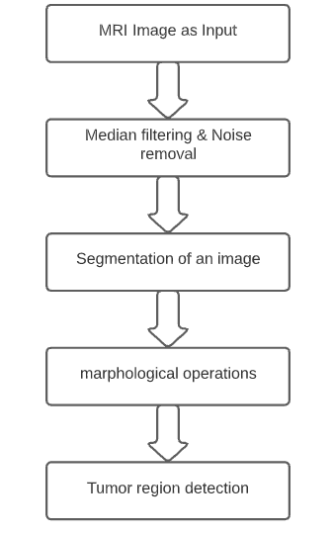
METHODOLGY

Slide 6
SOFTWARE REQUIREMENTS
Visual studio code
Images
Image processing tool

Slide 7
MODULES
Input MRI image
Image processing
Feature extraction
segmentation
Area calculation and detection

Slide 8
Module Description
Input MRI Image:
In this module using Uiget function the 2-D MRI Images are given as input.
Uiget file function helps the user to access the files from the current folder or other folders. When we execute the command it shows one dialog box where we can choose a file by selecting the file or by typing the name of the file. If out file is not available in a current folder then we can browse the folders from the dialog box on left side of the dialog box.

Slide 9
Image processing:
Image processing:
Generally captured image is of poor quality so Image processing is required for Noise filtering in the image and also for sharpening the image
RGB to grey conversion and Reshaping is also done in this step.
It includes median filter for noise removal.
Image processing step is useful before going for the Segmentation of the image.

Slide 10
Feature extraction:
After image processing the clustered image has extracted from
the processed image. The extracted cluster is given to the Thresholding process it applies binary mask over the entire image which gives the output as dark pixel becomes darker and white becomes whiter. In threshold coding, each transform coefficient is compared with a threshold value.
If (transform coefficient) < (threshold value) then the value assign to them is 0. In this case it is treated as “Background” which will be neglected.
if (transform coefficient) > (threshold value) then the value assign to them is 1.In this case it is treated as “Foreground” which will be highlighted.

Slide 11
Image segmentation:
Image segmentation is used to convert the image in to more meaningful image. The main objective of image segmentation is to extract various features of the images that may merge or split in order to build objects of interest on which analysis and interpretations Performed.
In this edge detection of an tumor image can be done by segmentation

Slide 12
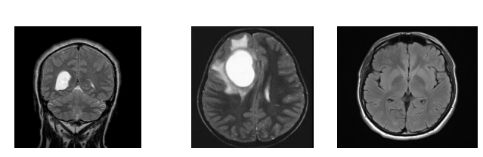
DATA SET:
A single abnormal images is taken as input to detect tumor. The input mages are of 256*256 with 8 –bit grayscale images.

Slide 13
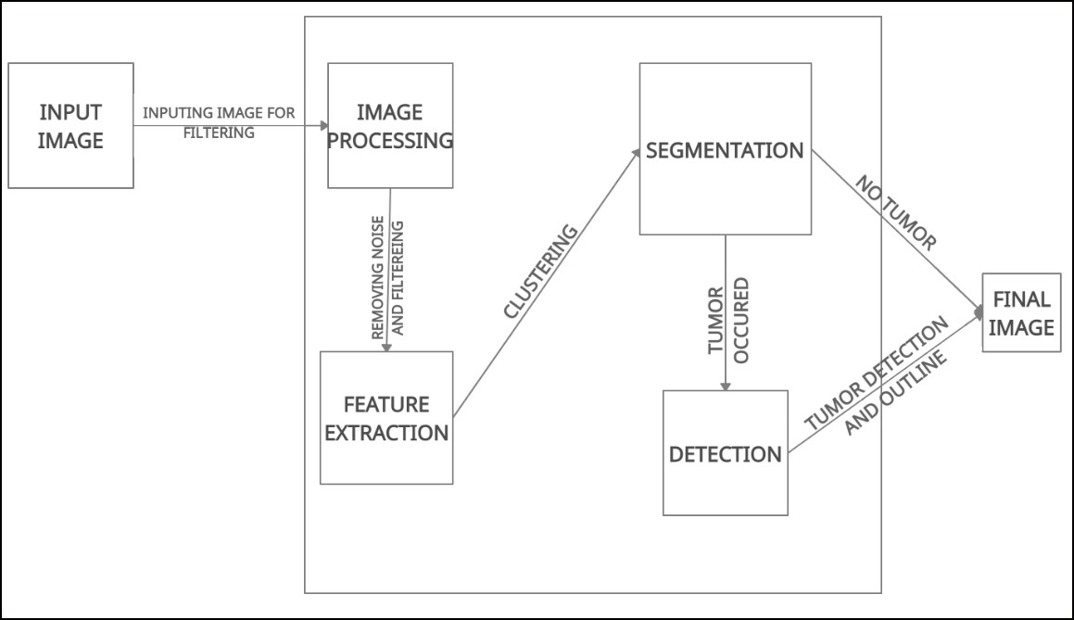
SYSTEM ARCHITECTURE

Slide 14
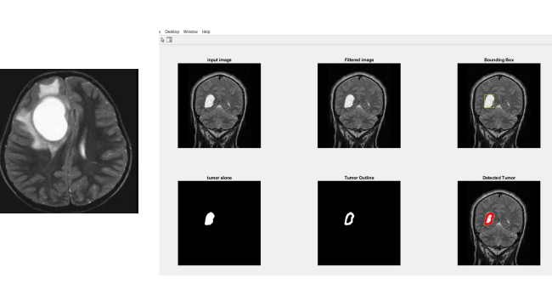
RESULTS AND DISCUSSION:
TUMOR:

Slide 15
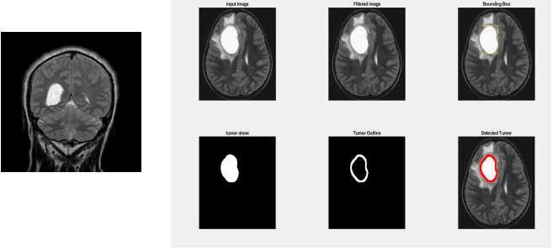

Slide 16
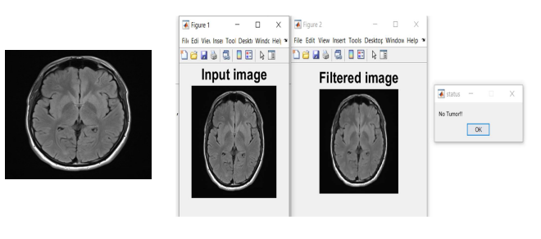
NO TUMOR:

Slide 17
Conclusion
From our Project, we will be able to design an automated tool for Brain tumour quantification using MRI Images. It will be able to identify accurate and meaningful information from MRI Images with minimum errors.

Slide 18
REFERENCES:
https://www.researchgate.net/publication/323775063_Advanced_Brain_Tumour_Segmentation_from_MRI_Images
https://www.researchgate.net/publication/275522126_Implementing_Tumor_Detection_and_Area_Calculation_in_Mri_Image_of_Human_Brain_Using_Image_Processing_Techniques
THEND

